Slide 1

How to make your own model in SasView?
Wojtek Potrzebowski
SciLifeLab Lund
wojtek.potrebowski@scilifelab.se

Slide 2
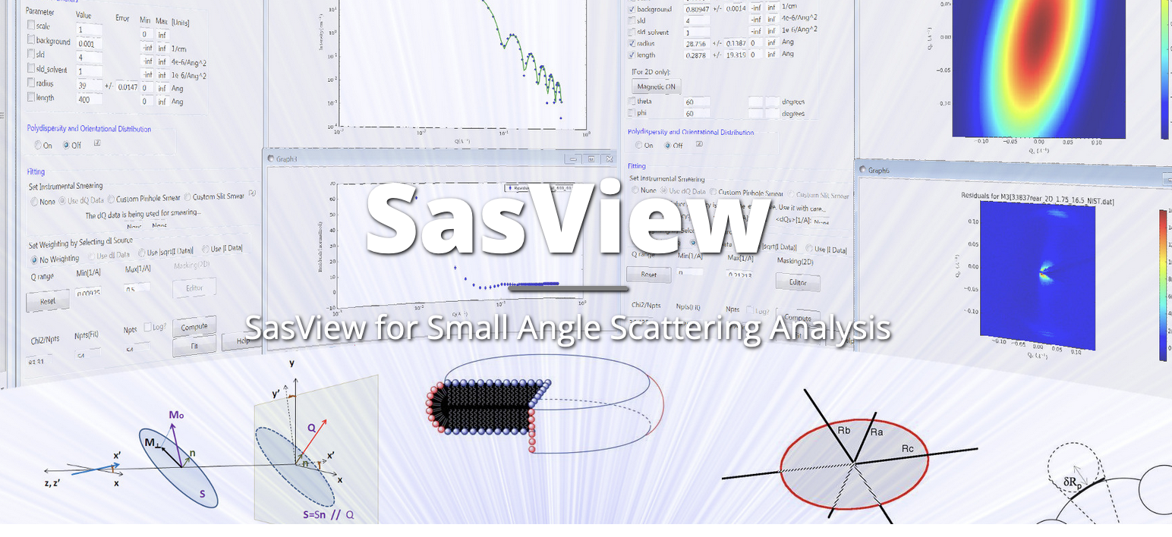
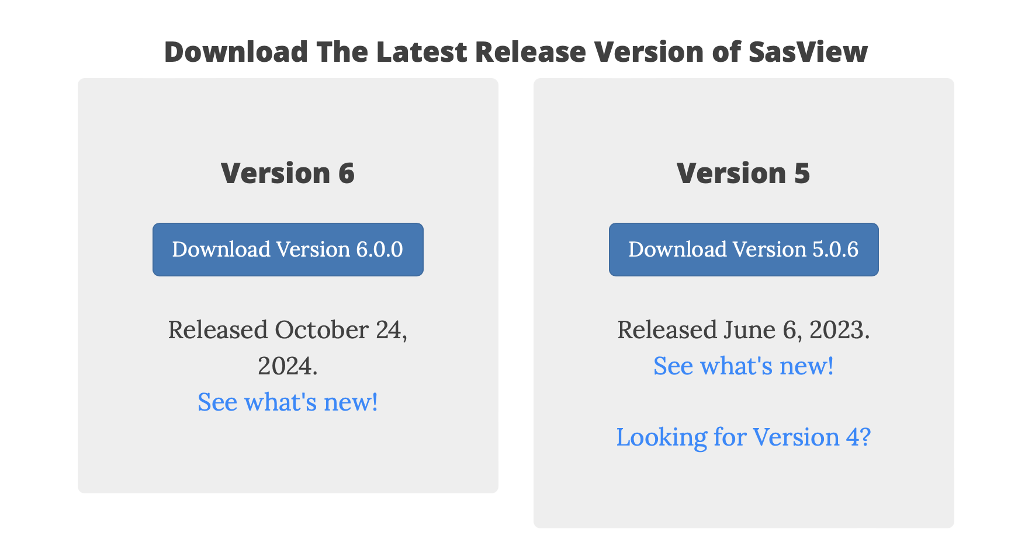
Before we start…
www.sasview.org

Slide 3
Learning objectives
Principles of Small Angle Scattering Data Analysis
Main functionalities of SasView
Newly developed features
SasView Community
Hands-on session
Creating custom plugin models
…

Slide 4
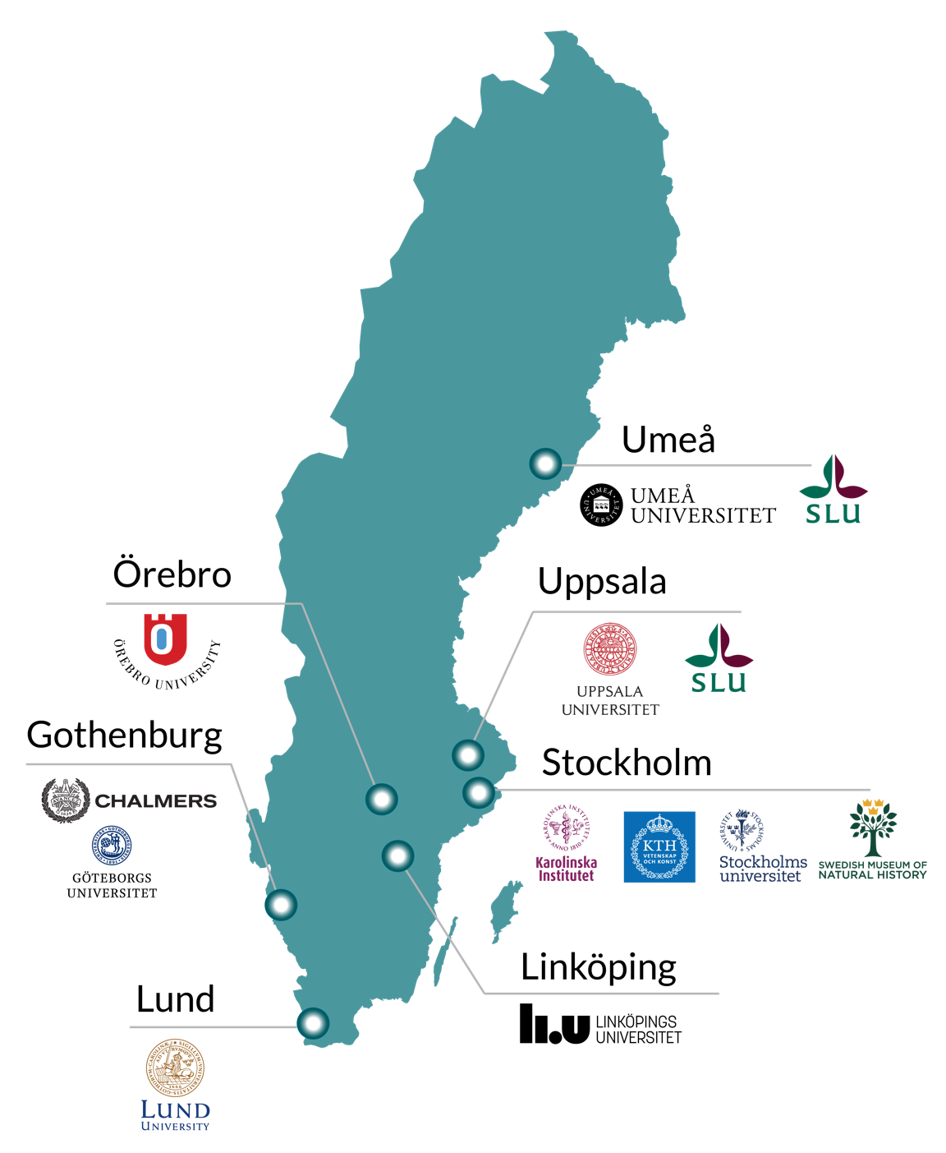

What is SciLifeLab?
National hub enabling life science
research that would otherwise not be possible.
Activities at all major Swedish universities.
Organised in 10 technology platforms and 40 research units distributed nationally.
Study all molecular aspects of life, from the atomic scale up to entire ecosystems.
Applicable across a large spectrum of disciplines and research fields in life science
What do we offer?
Who can access it?
Advanced technologies
Unique instruments
Expert know-how
Academia
Industry
Healthcare
Other governmental agencies
International users

Slide 5
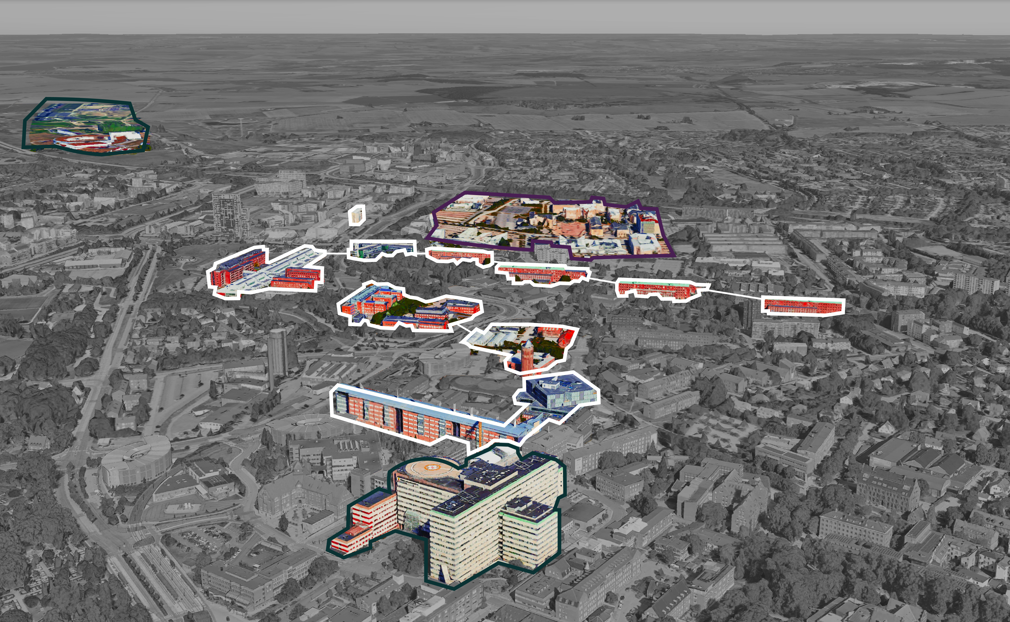
SciLifeLab Lund
SciLifeLab Lund
European Spallation Source
MAX IV
Medicon Village
Medicon Valley – leading life science cluster in Europe
50,000+ students
world-leading research infrastructure (MAX IV, ESS and SciLIfeLab)
Excellent research environments
Cancer
Diabetes
Stem Cell reseach
Neurodegenerative diseases
eHealth
BECC
LINXS
Faculty of Engineering
SciLifeLab Lund
Faculty of Science
Strong translational profile with well-established collaborations with Region Skåne
Unique environment for:
Structural biology research: MAX IV, ESS, LINXS, LU-fold, Structural Proteomics, Cryo EM, LBIC)
Single-cell applications
Faculty of Medicine
Skåne University Hospital
Notes:
Update buildings included in picture: ask Karin Nedler to help

Slide 6


User Journey at Large-Scale Facility
Data reduction
Experiment control
Data streaming
Data analysis
Proposal submission
Before experiment
During experiment
During and after experiment

Slide 7
User Journey
Facility
Responsibility+Expertise
Users
User Office Software
Experiment control
Data streaming
Data reduction
Data analysis

Slide 8
Data analysis – facts of life
Data analysis is part of the processing workflow
Reduced data on the disks is useless
Users expertise is critical for successful data analysis
Facilities should support data analysis software but shouldn’t fully drive the process
->We need open and collaborative software tools to succeed!

Slide 9
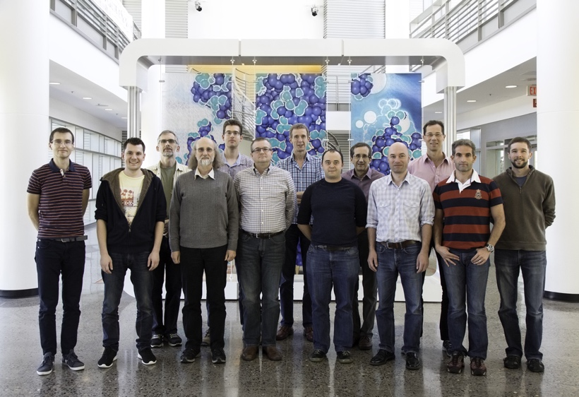
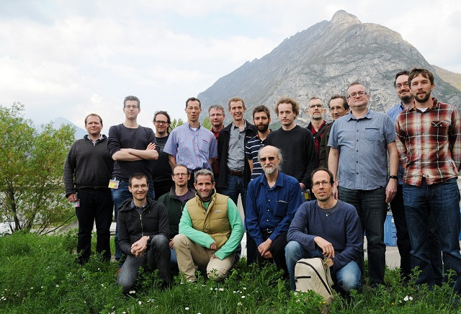
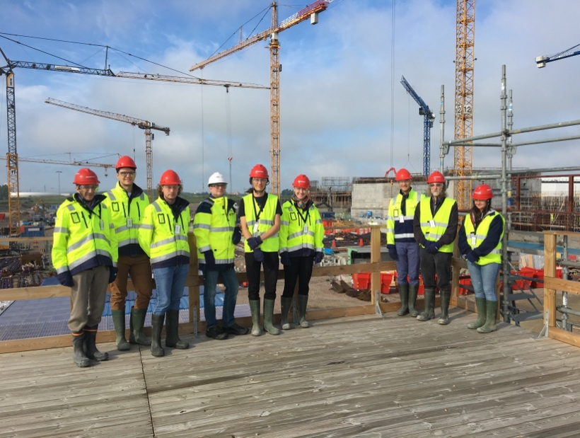
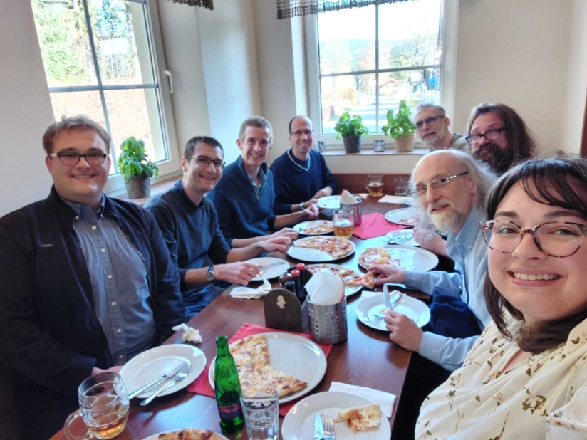
The SasView approach
An open, collaborative, community development
Community driven project
Supported by 10 facilities, 40 contributors (~15 active at any one time)
Small leadership team: Paul Butler (NIST), Steve King (ISIS), Wojciech Potrzebowski (SciLifeLab)
Biweekly calls
Regular SasView camps and hackathons
Hosted on github: https://github.com/SasView/sasview
Pictures from Code Camps: V, VI, VIII, X
www.sasview.org

Slide 10
SasView collaboration
Those who bring the resources (time, effort, funds) choose what to work on
but cannot break existing experiences ...

Slide 11
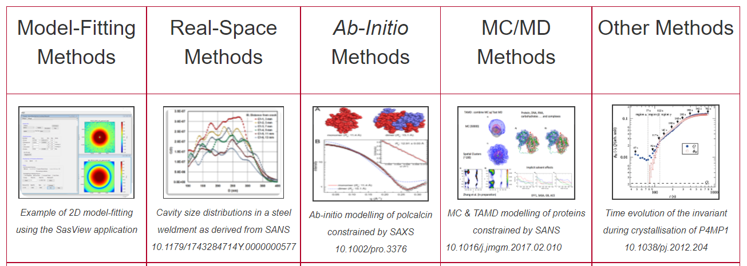
Different approaches to SAS data analysis
Not in SasView scope
https://www.isis.stfc.ac.uk/Pages/SANSdataanalysisOverview.aspx

Slide 12
Typical SasView workflow
For reduced data:
Load and plot experimental data
Define a model (form and structure factor) with parameters
Fit the parameters so that model matches experimental data
Draw scientific conclusions and publish results!

Slide 13
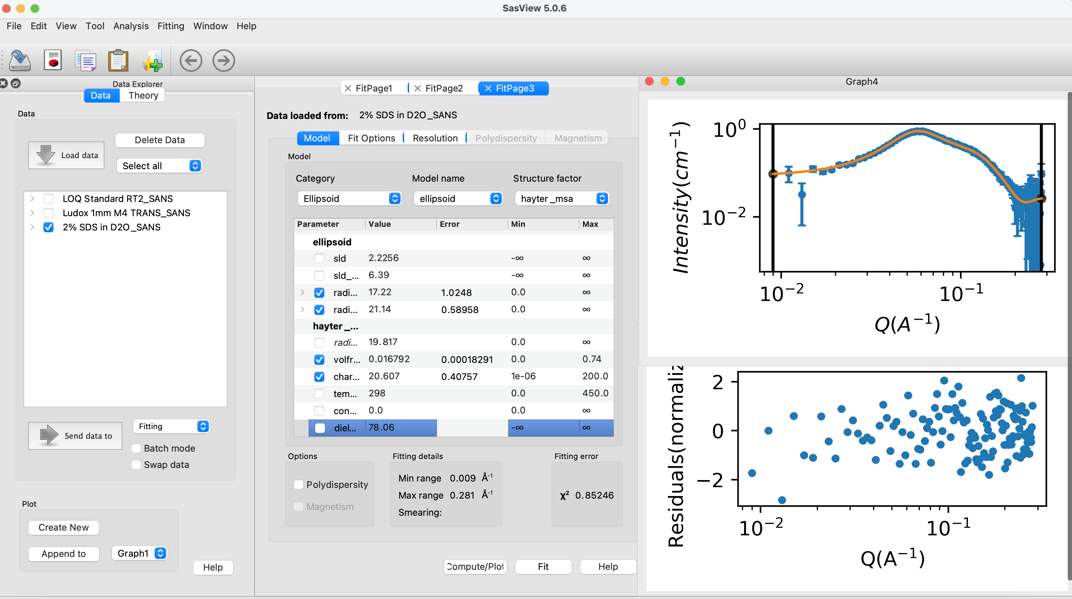
70+ models to explain data
Wide choice of built-in models (> 70)
F(Q), S(Q) & F(Q)*S(Q)
Single, batch and simultaneous 1D and 2D fitting
Data management
Common data formats supported, including NXCansas & cansas1D
Analysis Tool Choice
&
Plotting
Polydispersity (choice of distribution and distribution parameters)
Resolution smearing (pinhole and slit)
Automatically from data or provide parameters

Slide 14
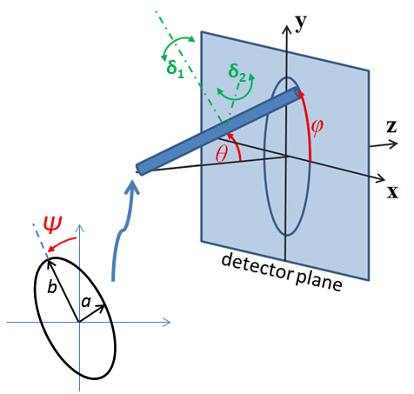
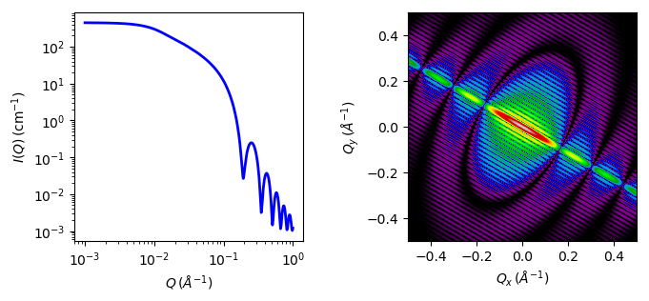
2D fitting for oriented or magnetic particles
1D and 2D cylinder model

Slide 15
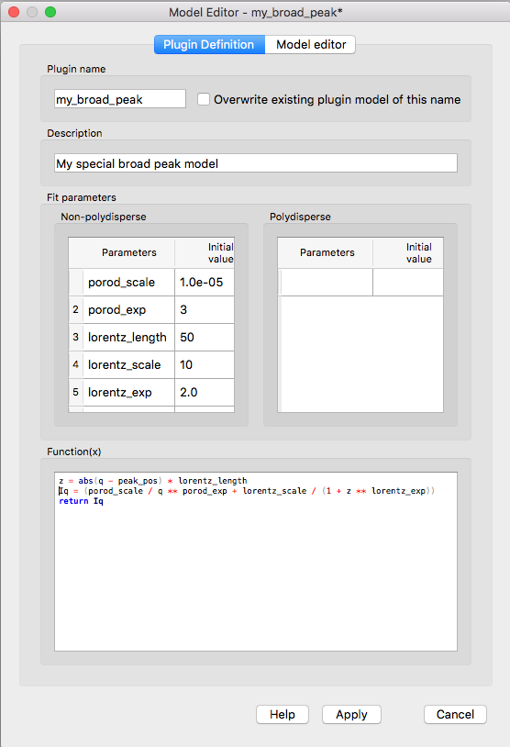
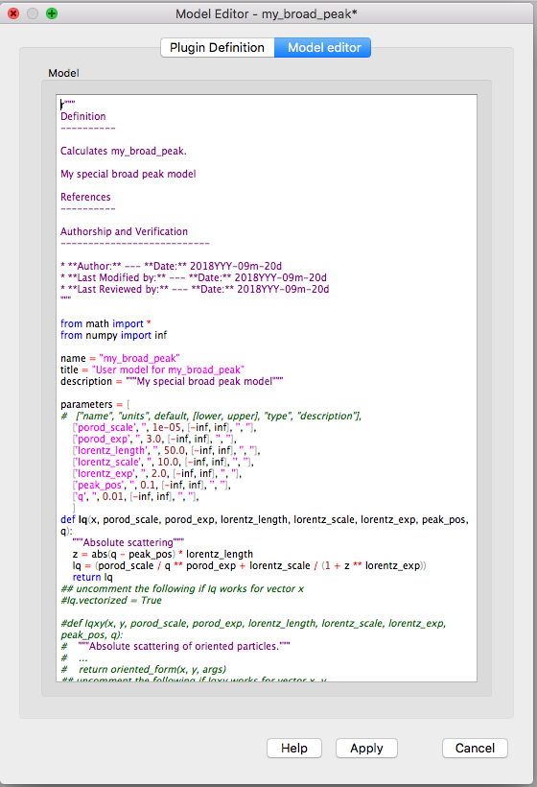
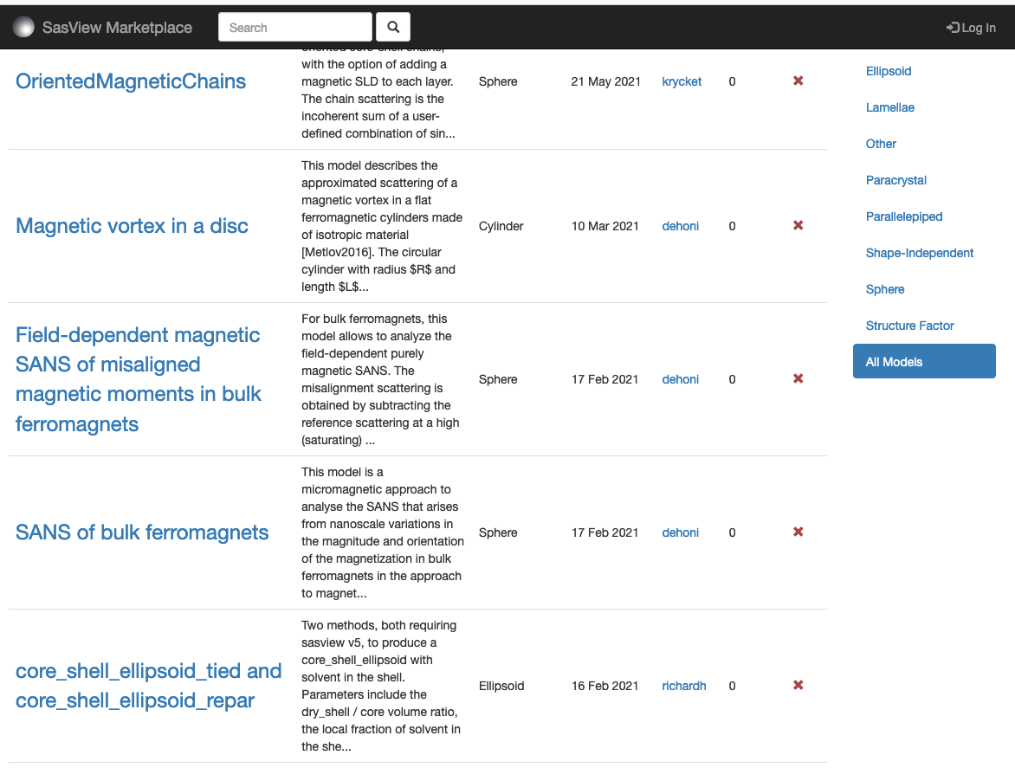
Plugin models
Dedicated editor
Syntax and performance testing
Directly available in SasView ecosystem
Community developed models can be deposited to marketplace: https://marketplace.sasview.org/

Slide 16
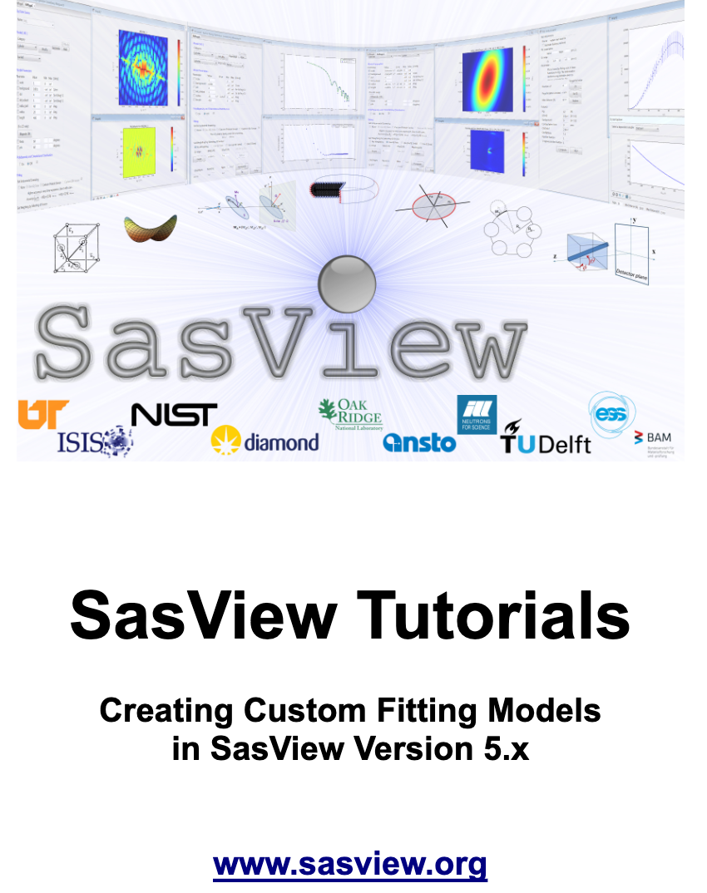
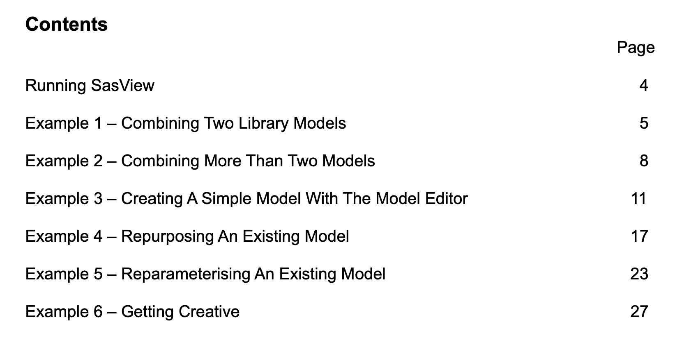
Plugin models tutorial
Available at https://www.sasview.org/download/

Slide 17
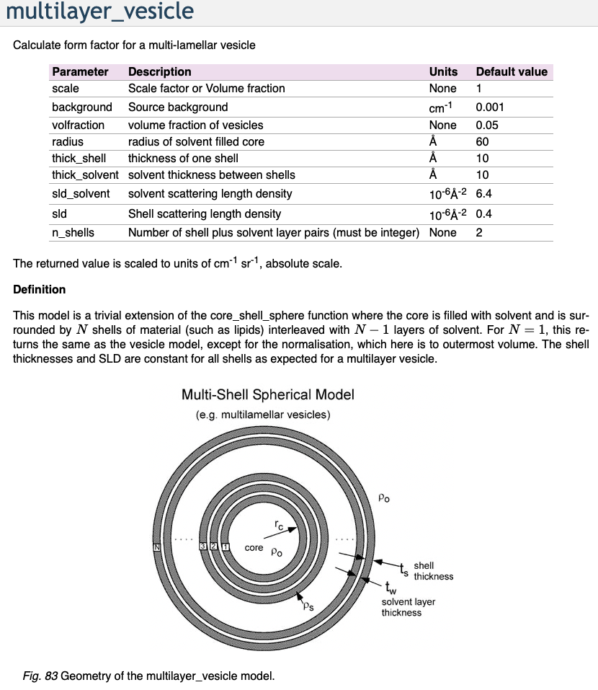
Which model should I use?
Prior knowledge
Literature search
SasView documentation
Usually, more than one model fits
Model-free analysis

Slide 18
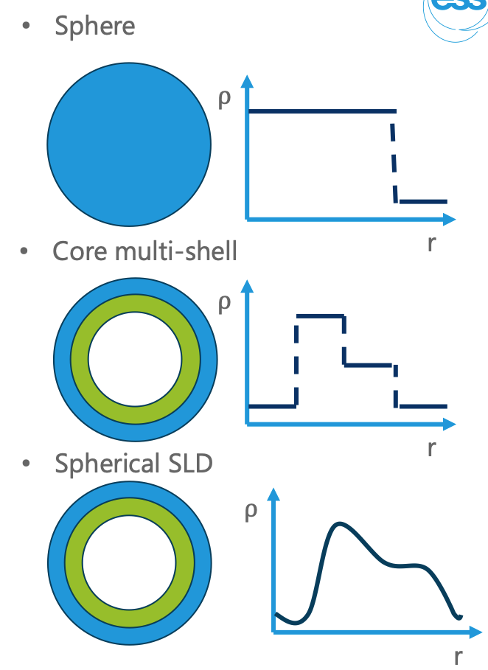
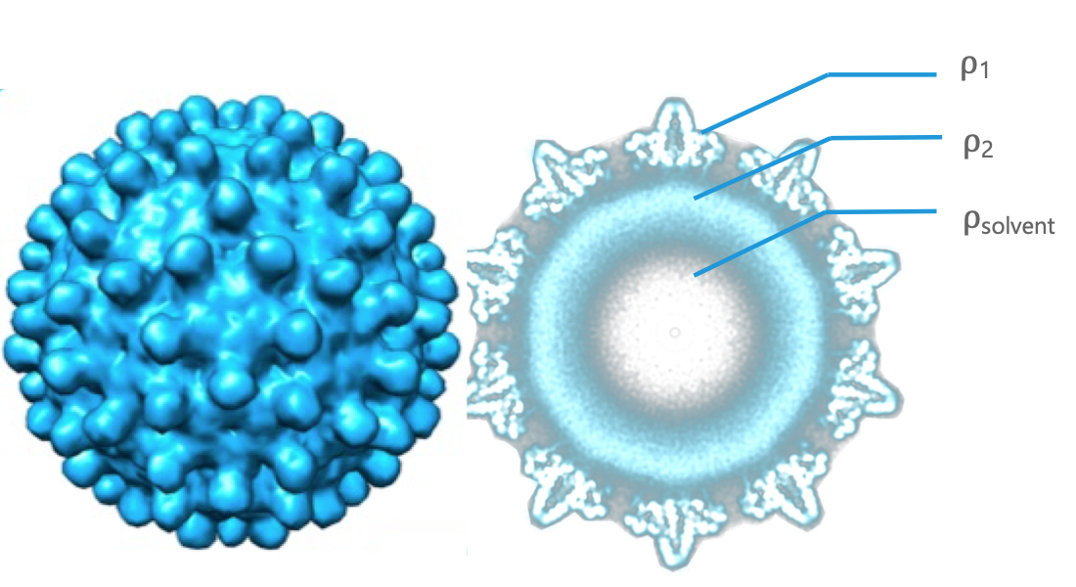
How to represent a virus capsid?

Slide 19
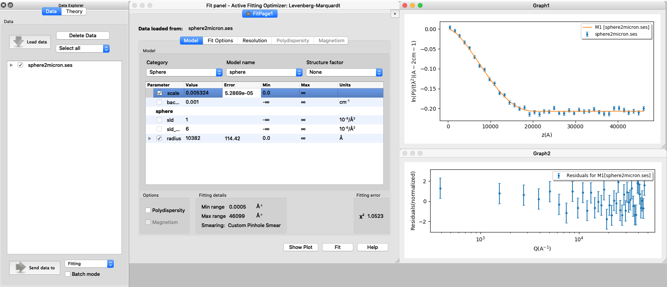
SESANS data
SasView recognizes SESANS data and starts specific workflow
Automatic Hankel Transform of SANS models
Access to all SasView models

Slide 20
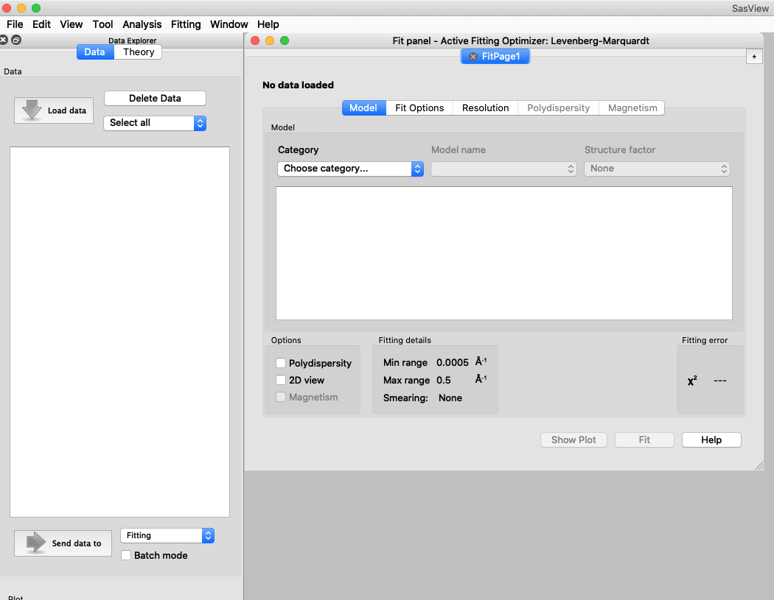
Other SasView functionality
Tools
Data Operation
SLD calculator
Density/Volume calculator
Slit Size Calculator
Kiessig Thickness Calculator
Q Resolution Estimator
Generic Scattering calculator
Orientation Viewer
Python Shell/Editor
Image Viewer
File Converter
Analysis
Fitting
Invariant
Pr Inversion
Correlation Function

Slide 21
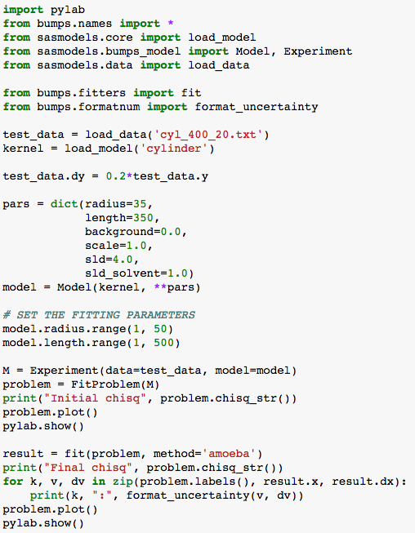
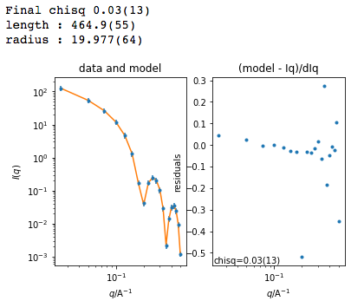
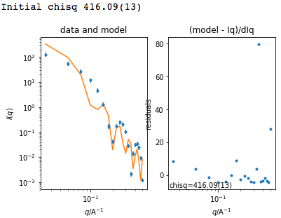
Beyond Graphical User Interface (GUI)
Useful for batch jobs and reproducibility
Scripts can be run on computer cluster
Before fit
After fit

Slide 22
Beyond Graphical User Interface (GUI)
sasview
sasdata
sasmodels
bumps
Python installation
For fitting, there is no need to install sasview
Pip install sasmodels sasdata bumps
It can be run on computer clusters (also with GPU)

Slide 23
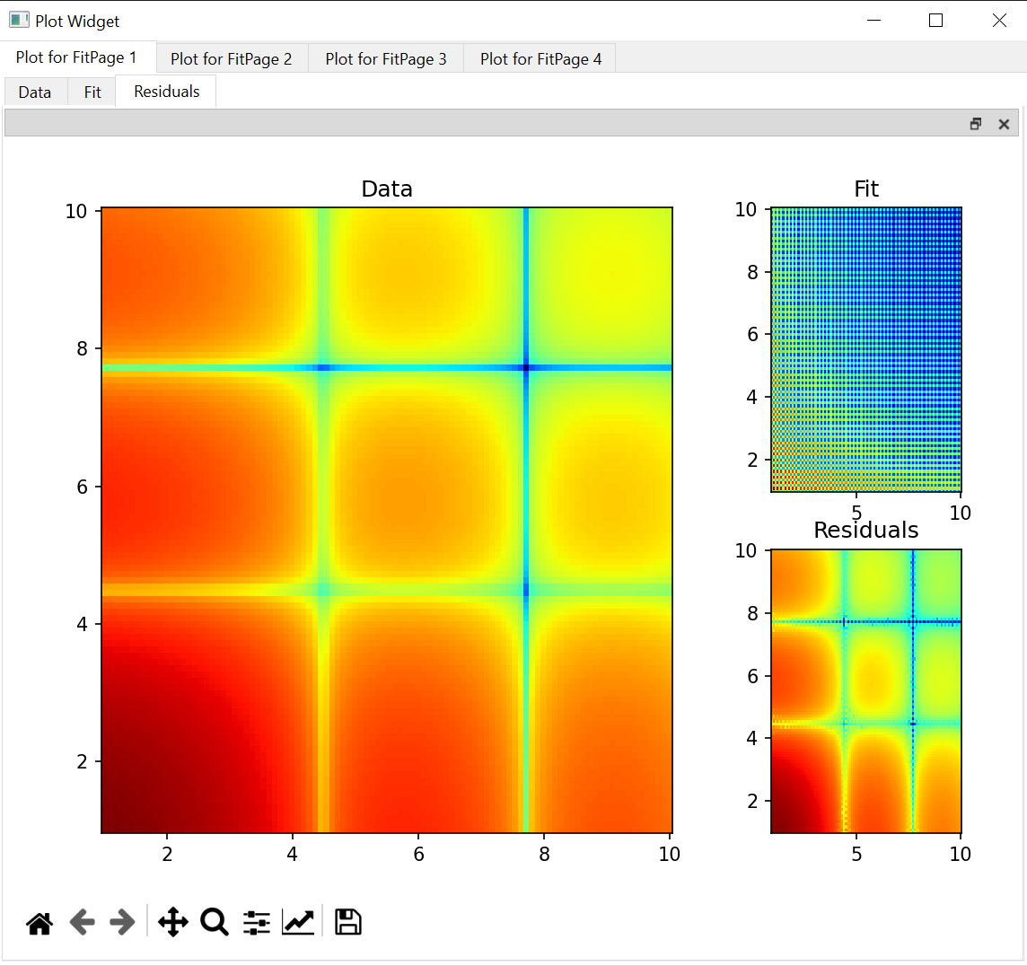
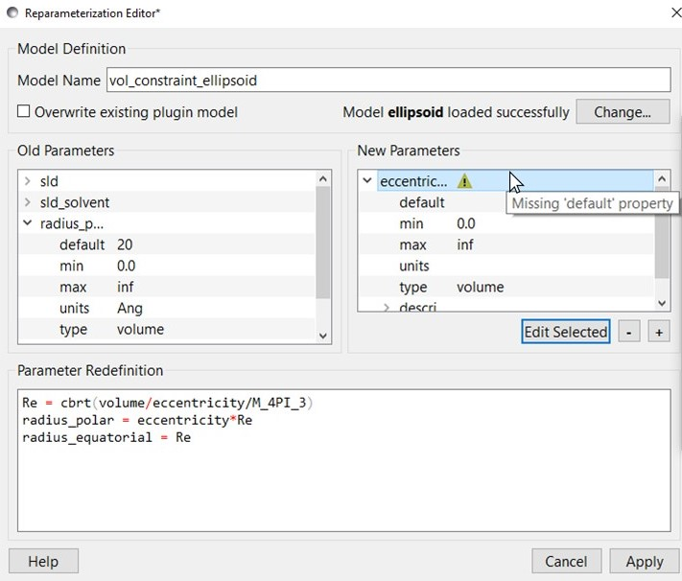
Student projects and ”external” contributions
Simultaneous SAXS and SANS fitting
Improvements in:
Plotting
Data structure
Documentation
Plugin Editor
Slicers
Generic Scattering Calculator
Web-based API
Pore size distributions
Contributors: Iestyn Cadwallader-Jones, Nouhalia Agouzal, Dorian Lozano, Julius Karliczek (ILL), Ellis Hewis, James Crake-Merani, Ruben Lopes (ISIS), Alex Zheng (NIST), Brayden Miller (NIST), Xael Shan (NIST), Anita Zhang (Princeton), Kristian Lytje (Arhus University)

Slide 24
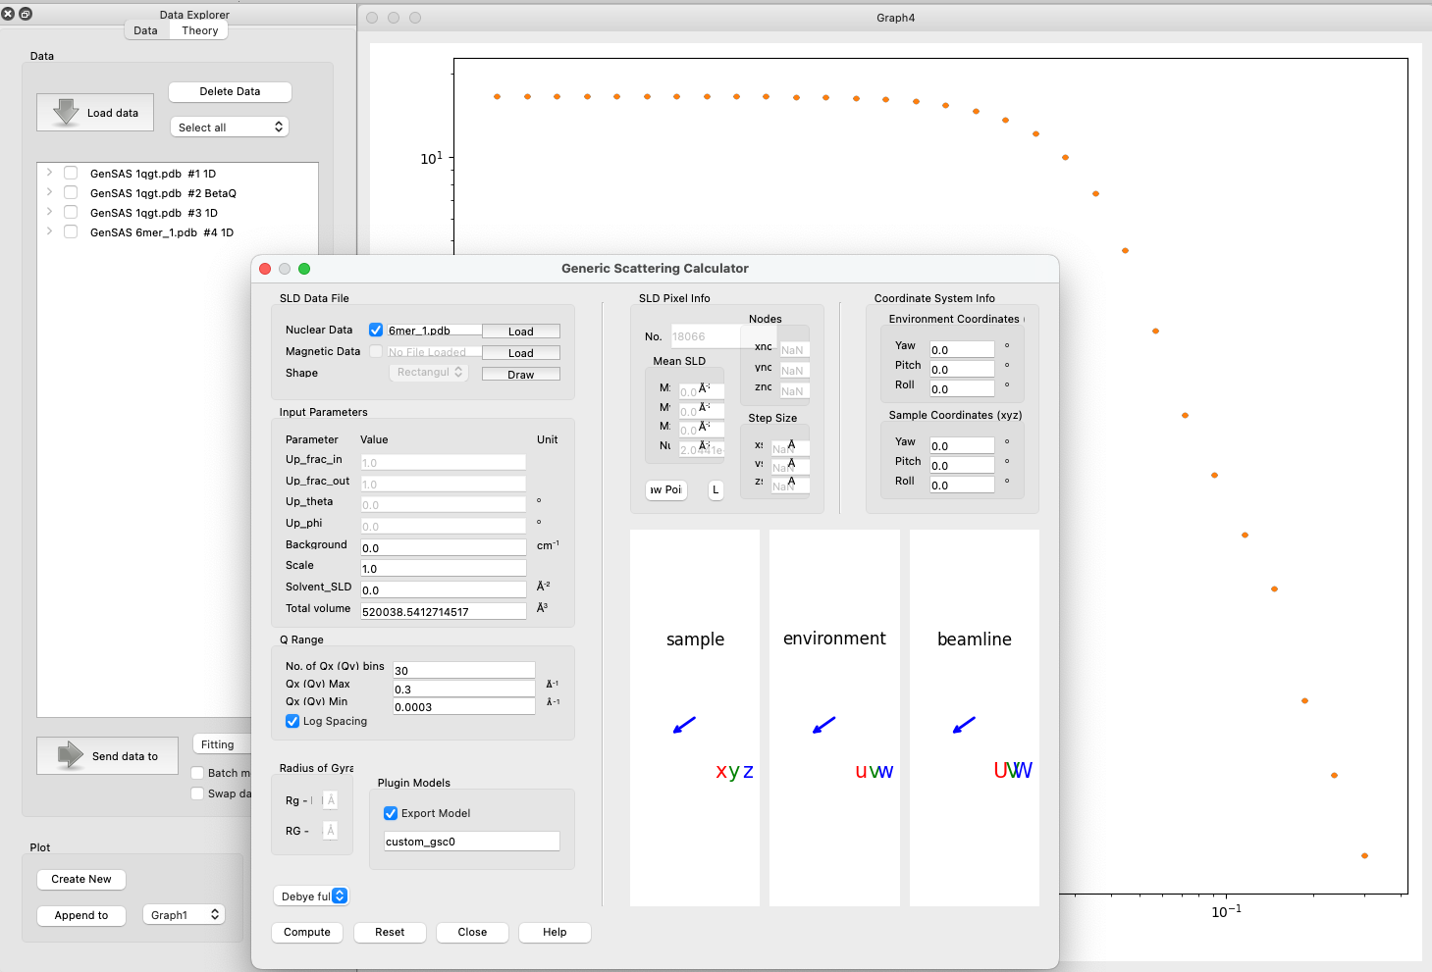
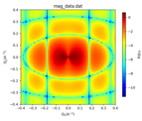
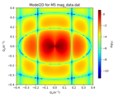
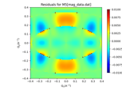
Generic Scattering calculator improvements
Magnetic/polarized SANS
Generic Scattering Calculator supports magnetic/polarized SANS
Coordinate data in VTK formats supported
Interacting bio-molecules
Generate scattering profile from PDB file
Save as a custom/plugin model
Use for fitting with structure factors (including beta approximation)
PDB reader and engine refactored
Validation of electron-microscopy maps using solution small-angle X-ray scattering
Kristian Lytje and Jan Skov Pedersen, Volume 80| Part 7| July 2024| Pages 493-505

Slide 25
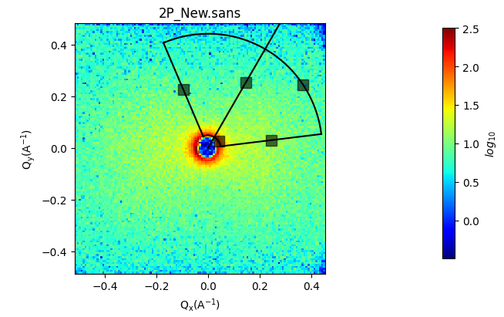
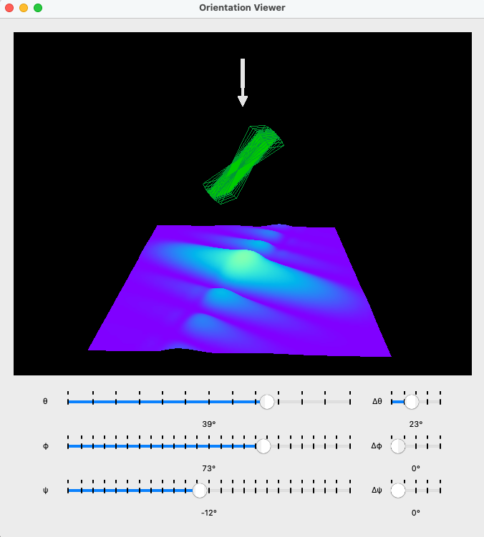
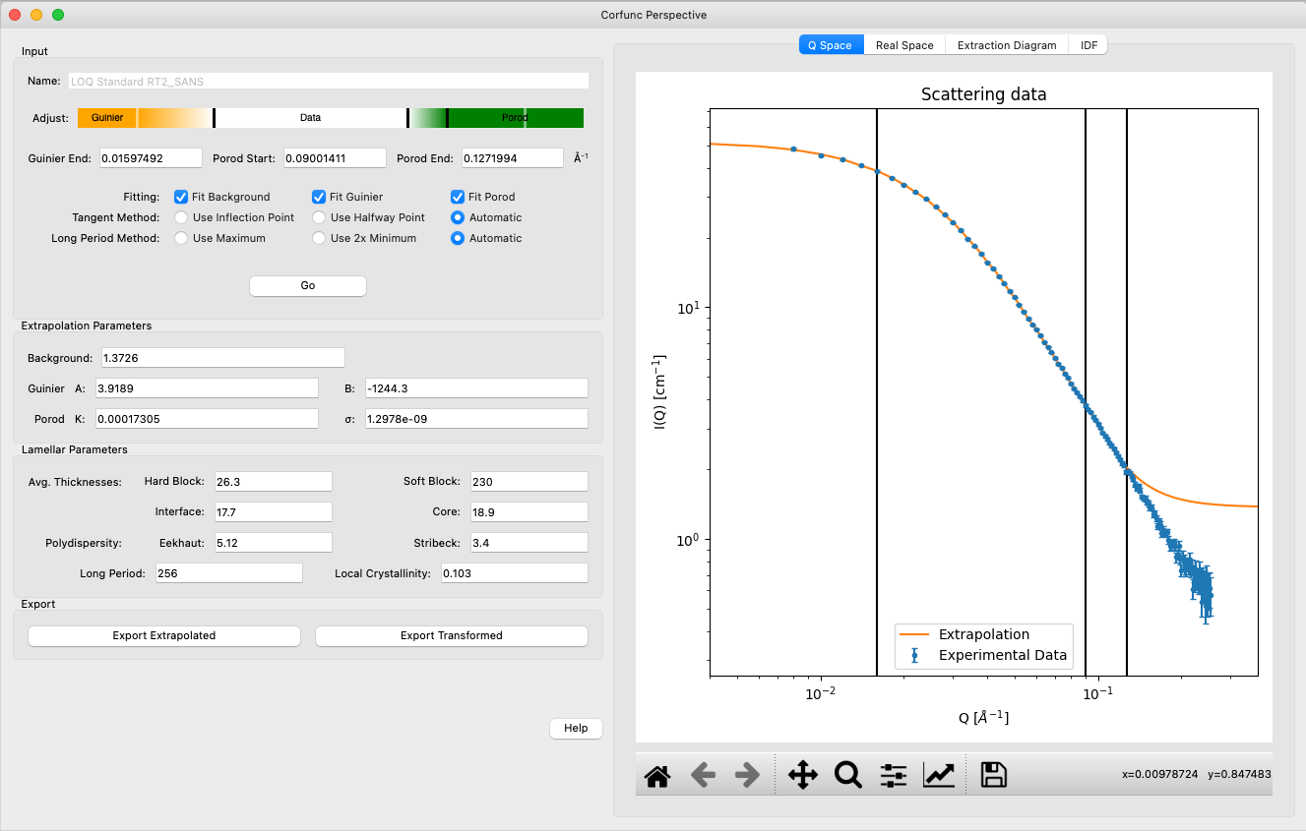
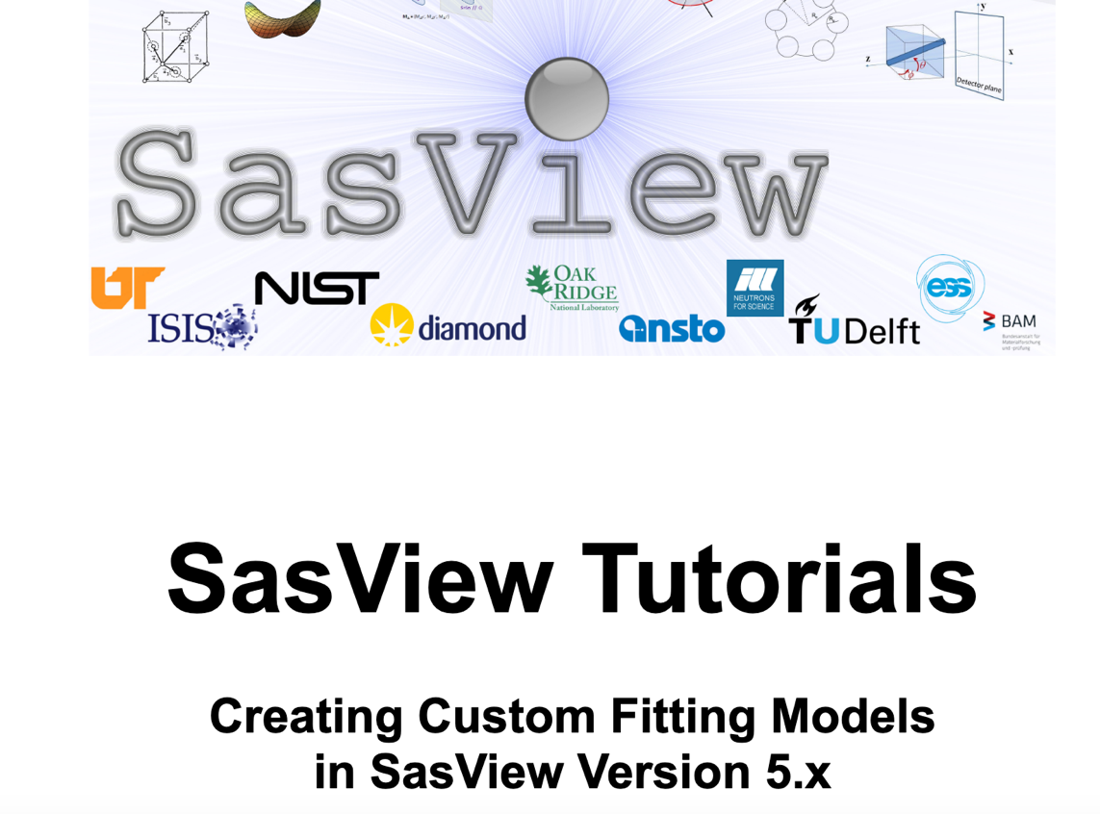
SasView 6.0.0
Orientation viewer available
Corfunc perspective refactored
Simultaneous fitting allows for a weighting scheme
Preferences panel with display and plotting options
Improved label handling on plots
Residuals plots refactored
PDB reader refactored
Wedge slicer added
Sasdata package separated
Custom Model writing tutorial
https://github.com/SasView/sasview/releases/tag/v6.0.0

Slide 26
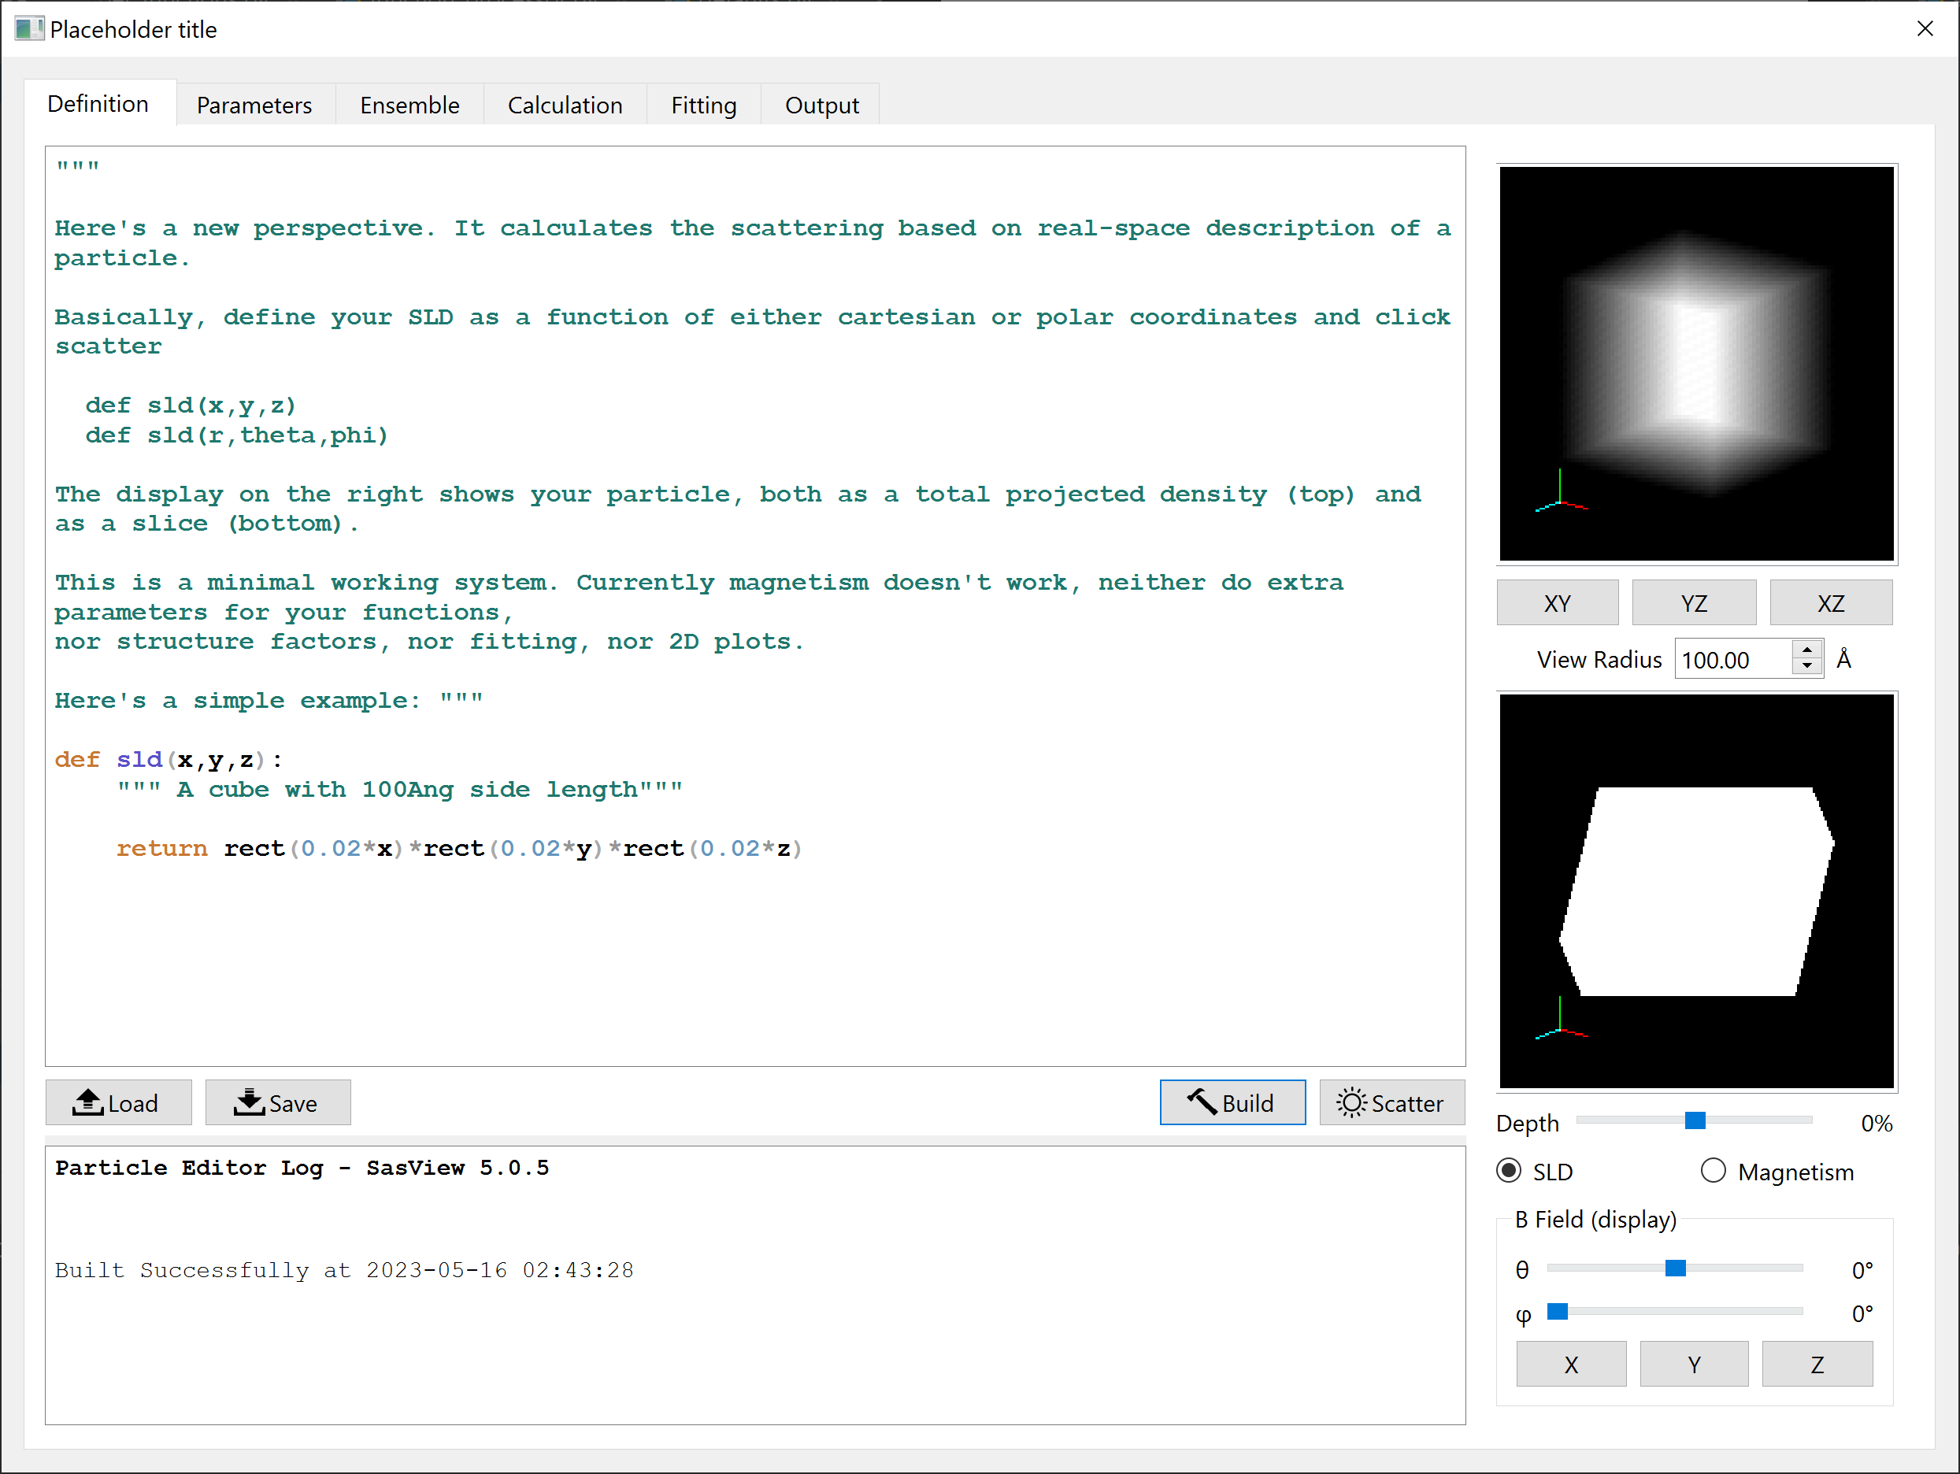
Features beyond 6.0.0 - particle editor
Define functions
sld and (optionally)
magnetism
sld / magnetism
“x-ray” projection
sld / magnetism
cross section
Feedback on
code and calculations
Magnetic field
controls for display
“Recompile” and
update display
Compute
scattering
Lucas Willkins (ISIS)

Slide 27
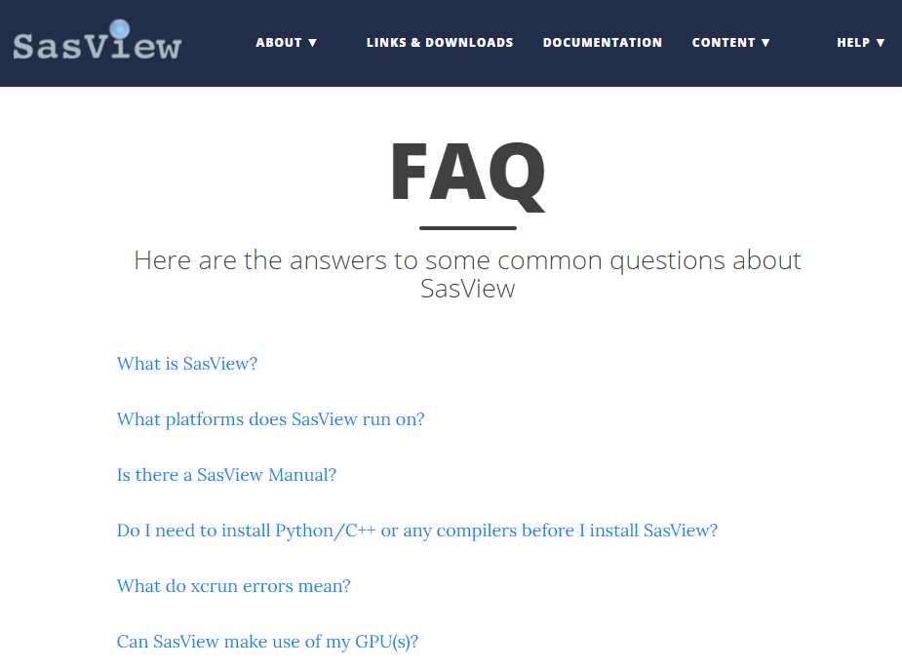
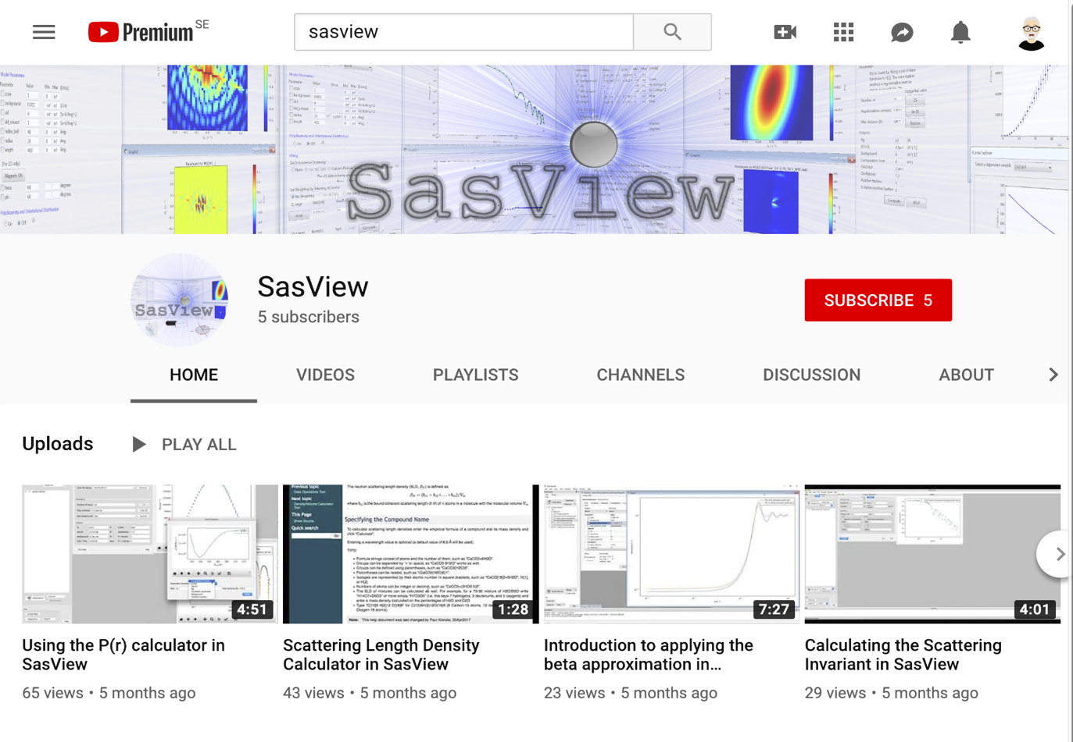
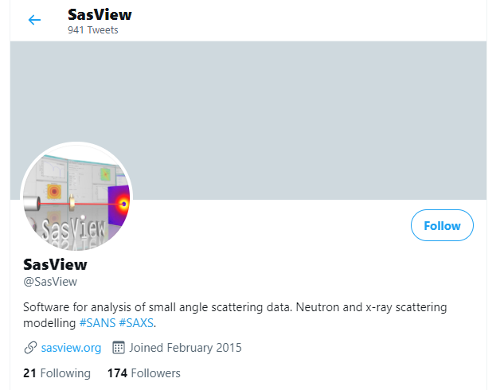
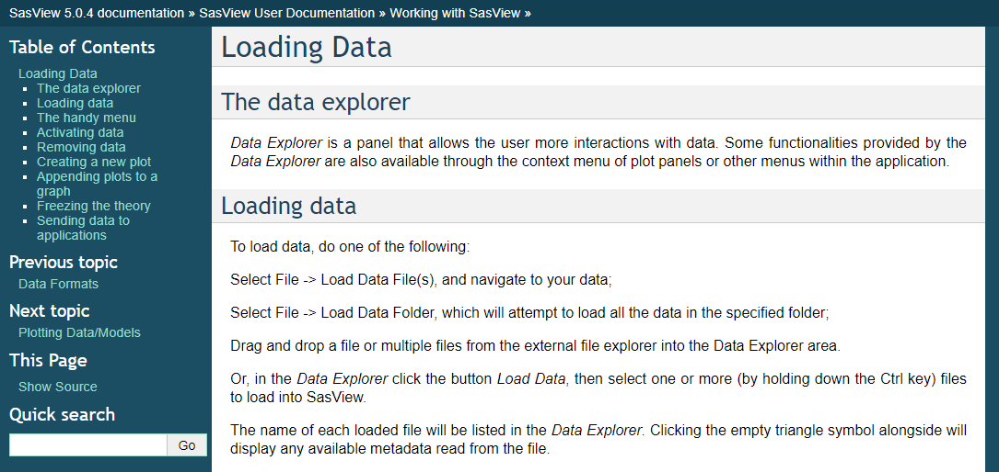
Resources for users and developers
Website
Documentation
in-program & online
Written Tutorials
Video Tutorials (YouTube)
Taught Courses
scattering schools/workshops
university courses
Bootcamps & regional workshops
e-Learning
Slack
Twitter
(Marketplace)
help@sasview.org
users@sasview.org

Slide 28
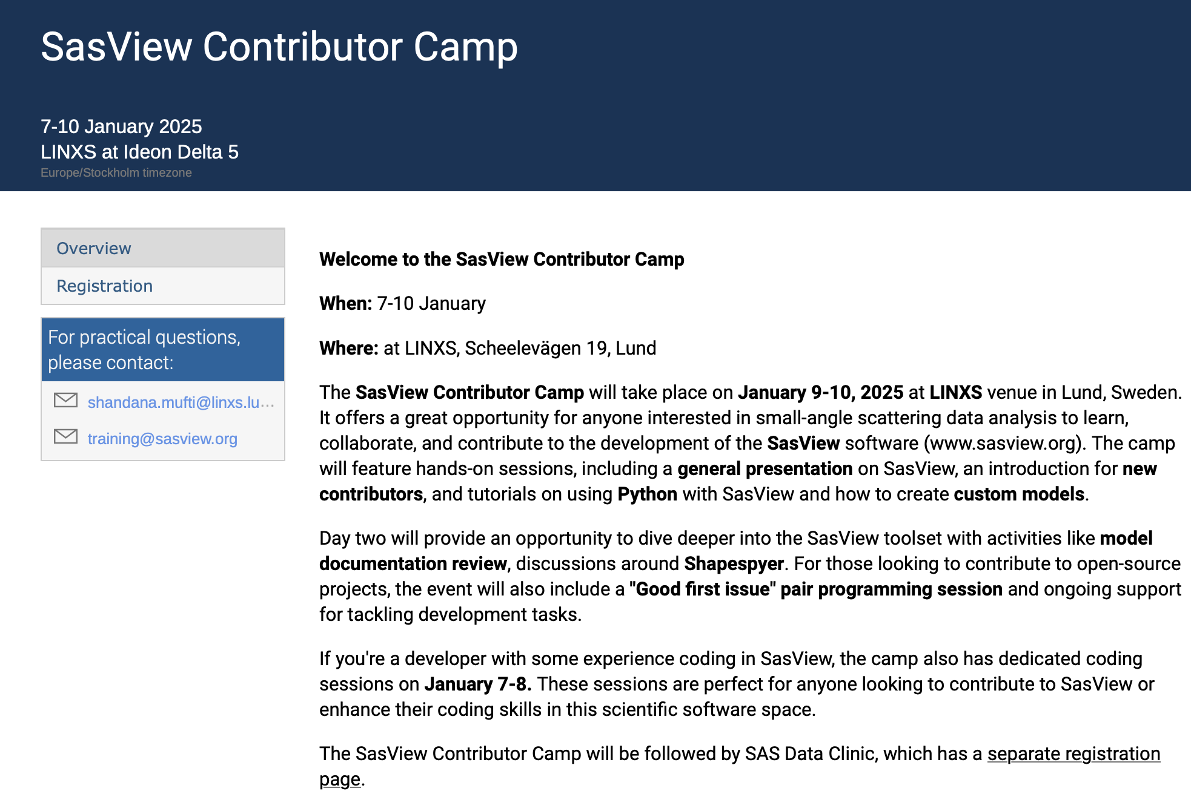
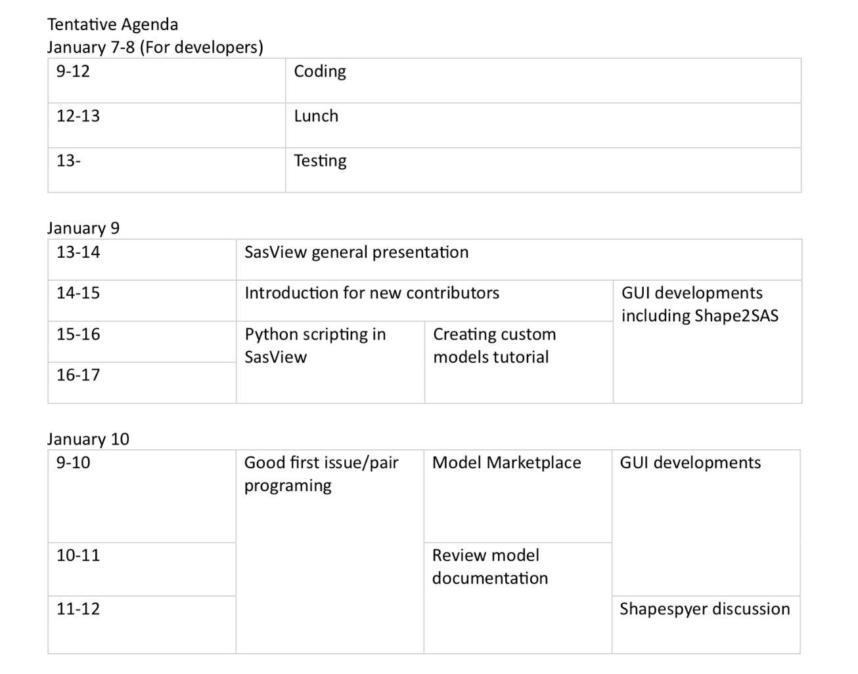
Mini Contributor Camp in Lund, Jan 9-10
https://indico.linxs.lu.se/event/526/

Slide 29
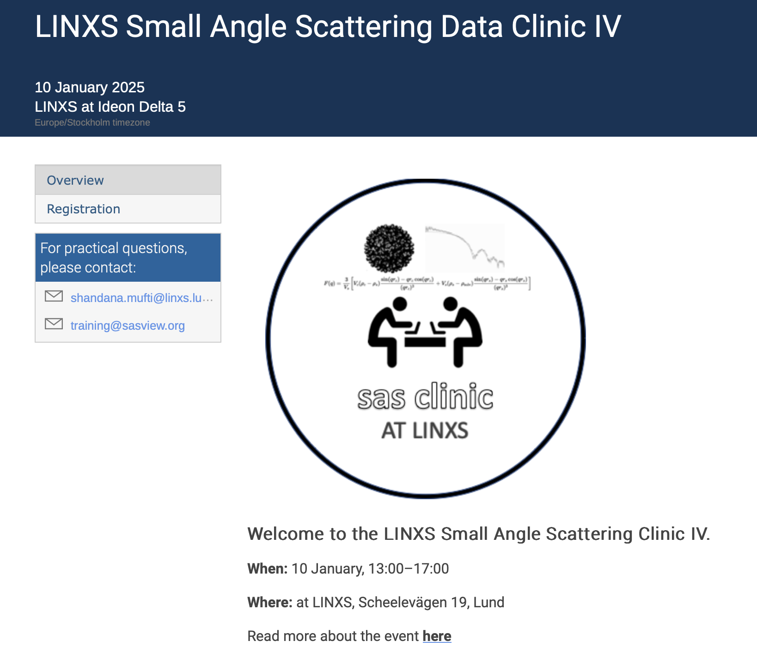

SAS Data Clinic

Slide 30
How to contribute
Respond to queries posted to help@sasview.org or github
Teach others how to get the best from SasView
Write and improve documentation
Write and record tutorials
Test SasView (over and over!) and write bug reports
Provide new plugin models
Deploy and improve automated testing
Review the code contributions of others
Develop code in Python3/C and PyQt/Matplotlib
www.sasview.org/contribute

Slide 31
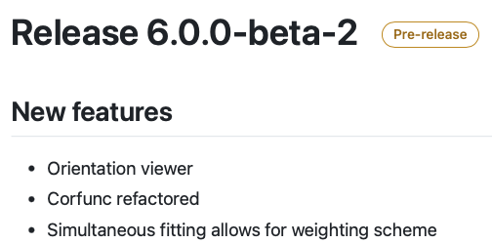
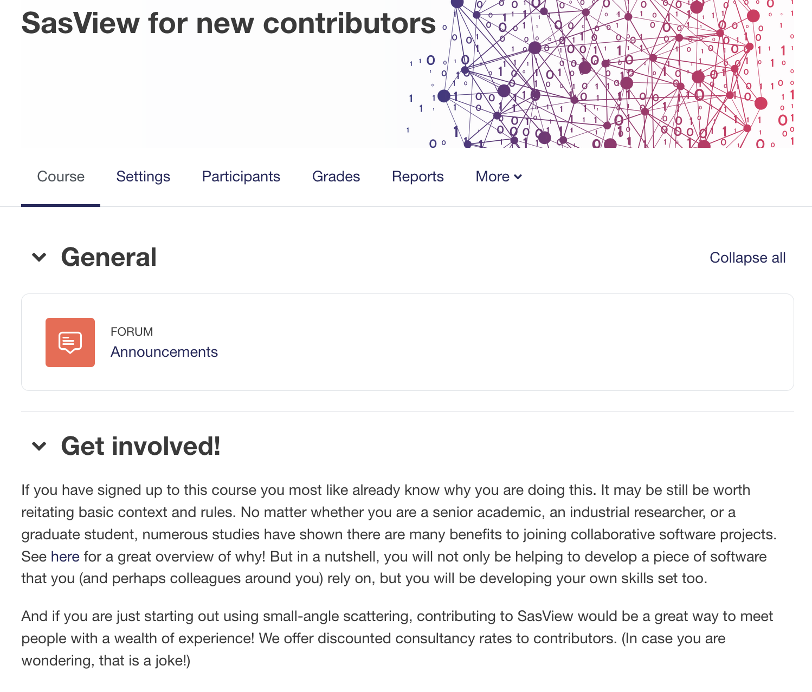
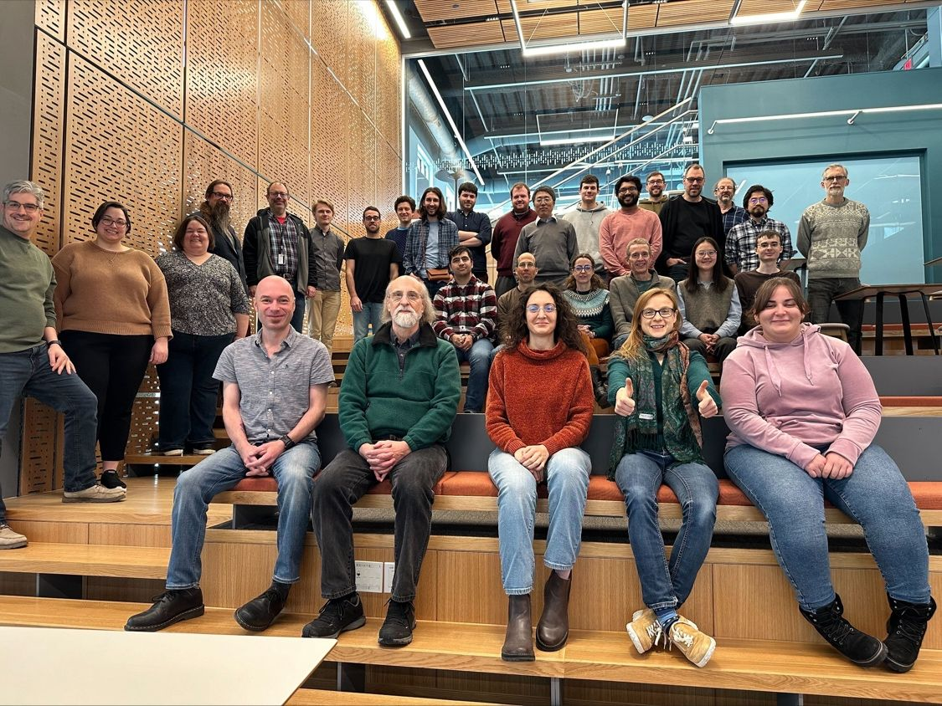
Resources for contributors
Reducing entry barier and improving release cycles frequency
Faster release cycles
E-learning course
Contributor Camp
https://e-learning.pan-training.eu/course/view.php?id=52

Slide 32
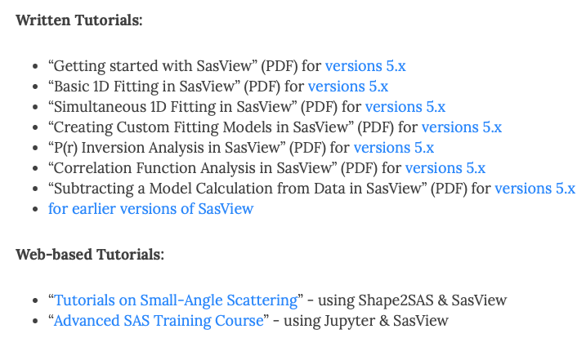
Hands-on session
New to SasView? Start here
3
1 or 2
https://www.sasview.org/documentation/

Slide 33
Experimenting with SasView
Run SasView from the script:
Setup python environment
Install required packages
Play with some of the notebooks: https://github.com/SasView/documents/tree/master/Notebooks

